Slide 1
CineSuggest-A movie recommendation website
Padala Surya Sahith(21BCE1548)
Sidhartha Sankar Panda(21BCE5738)

Slide 2

Software technologies
The Following Software Technologies have been used:
Front End:
Hypertext Markup Language(Html)
Cascading Style Sheets (CSS)
Javascript
Backend:
Flask
Jinja2
Numpy
Pandas
Scikit

Slide 3
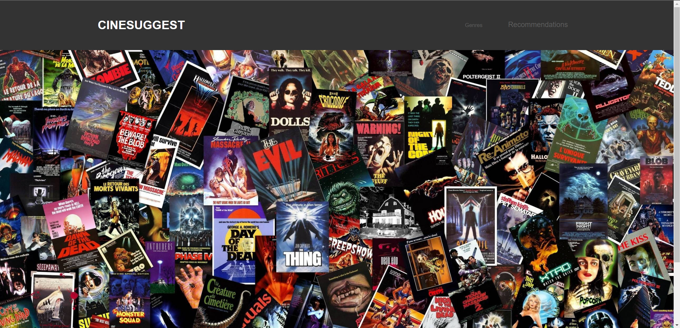
Overall design

Slide 4
Contribution of each
Sidhartha Sankar Panda
Helped develop the logic and problem statement
Tested the code for any error
Made the document
Padala Surya Sahith
Code made for the Front End of the webpage
Made the UI

Slide 5
Future Work
We will be adding the backend and the recommendation system based on machine learning that will be able to fetch the results from backend based on user’s behaviour and genre preference

